Slide 1
LAB 4
Using C, write a program to compute 4 arithmetic operators (as separate functions) on two entered integer numbers using pointers.

Slide 2
SORTING & SEARCHING TECHNIQUES
There are many techniques and algorithms of sorting arrays and searching a specific data in an array.
Searching techniques
Essentially, we distinguish two methods of searching a specific value in an array.
The two methods are linear or sequential search and binary search.

Slide 3
SORTING & SEARCHING TECHNIQUES
Linear search
In linear search, each element of an array is read one by one sequentially and it is compared with the
desired element.
A search will be unsuccessful if all the elements are read and the desired element is not found.

Slide 4
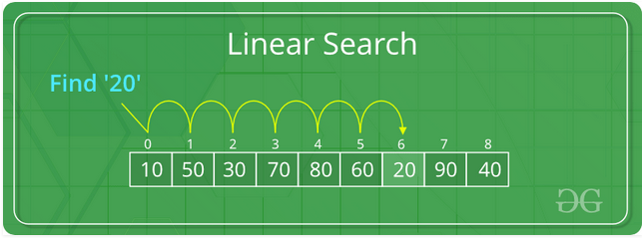
SORTING & SEARCHING TECHNIQUES
Assume that A is an integer array of n elements, in which we would like to know that a specific element
is findable in A.

Slide 5
SORTING & SEARCHING TECHNIQUES
The following function will return the position at which the searched element can be found.
int linearsearch(int A[], int n, int elt)
{
int pos=-1;
for(int i=0;i<n;i++)
{
if(A[i]==elt)
{
pos=i;
break;
} }
return pos+1; }

Slide 6
SORTING & SEARCHING TECHNIQUES
Binary search
Binary search is an extremely efficient algorithm when it is compared to linear search.
Binary search technique searches “data” in minimum possible comparisons.
Suppose the given array is a sorted one, otherwise first we have to sort the array elements.

Slide 7
SORTING & SEARCHING TECHNIQUES
It apply the following conditions to search a “data”:
Find the middle element of the array.
Compare the middle element with the data to be searched, then there are following three cases.
If it is a desired element, then search is successful.
If the data is less than middle element, then search only the first half of the array, i.e.,
the elements which come to the left side of the middle element.

Slide 8
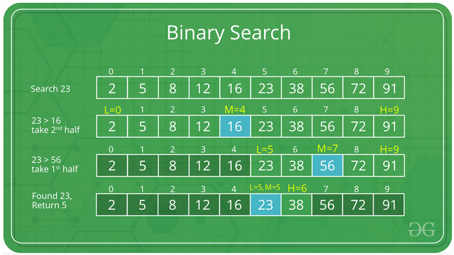
SORTING & SEARCHING TECHNIQUES
If the data is greater than middle element, then search only the second half of the array,
i.e., the elements which come to the right side of the middle element.

Slide 9
SORTING & SEARCHING TECHNIQUES
Repeat the same steps until an element is found or exhaust the search area.
The following function will perform binary search of an item in an array of n elements.
void searchbin(int arr[],int item,int n)
{
int end,start,middle;
end=n-1;
start=0;
middle=end/2;

Slide 10
SORTING & SEARCHING TECHNIQUES
while(item!=arr[middle] && start<=end)
{
if (item > arr[middle])
start=middle+1;
else
end=middle-1;
middle=(start+end)/2;
}
if (item==arr[middle])

Slide 11
SORTING & SEARCHING TECHNIQUES
printf(“\n%d found at position %d\n”,item,middle + 1);
if (start>end)
printf (“\n%d not found in array\n”,item);
}

Slide 12
SORTING & SEARCHING TECHNIQUES
Sorting techniques
The operation of sorting is the most common task performed by computers today.
Sorting is used to arrange names and numbers in meaningful ways.
For example; it is easy to look in the dictionary for a word if it is arranged (or sorted) in alphabetic order.

Slide 13
SORTING & SEARCHING TECHNIQUES
Let A be a list of n elements A1, A2, ....... An in memory.
Sorting of list A refers to the operation of rearranging the contents of A so that they are in
increasing (or decreasing) order.

Slide 14
SORTING & SEARCHING TECHNIQUES
Sorting can be performed in many ways.
Over a time, several methods (or algorithms) are being developed to sort data(s).
The following are the few sorting techniques:
Bubble sort,
Selection sort,
Insertion sort and
Merge sort,

Slide 15
SORTING & SEARCHING TECHNIQUES
Bubble sort
In bubble sort, each element is compared with its adjacent element.
If the first element is larger than the second one, then the positions of the elements are interchanged,
otherwise it is not changed. Then next element is compared with its adjacent element and the same
process is repeated for all the elements in the array until we get a sorted array.

Slide 16
The following function will sort any array using bubble method.
#include<conio.h>
#include<stdio.h>
enum bool(false,true);
void bubblesort(int arr[],int n)
{
enum bool permute=false;
while(!permute)
{
permute=true;
for(int i=0;i<n-1;i++)
{
if(arr[i]<arr[i+1]
{

Slide 17
int tempo=arr[i];
arr[i]=arr[i+1];
arr[i+1]=tempo;
permute=false;
}//end if
}//end for
}//end while
}//end function

Slide 18
SORTING & SEARCHING TECHNIQUES
Selection sort
Selection sort algorithm finds the smallest element of the array and interchanges it with the element in the
first position of the array.
Then it finds the second smallest element from the remaining elements in the array and places it in the
second position of the array and so on.

Slide 19
The following function will sort an array of n integers, using selection method.
void selectionsort(int arr[],int n)
{
for(int i=0;i<n-1;i++)
{
int imin=i;
for(int j=i+1;j<n;j++)
{
if(arr[imin]>arr[j])
imin=j;
}//end for int j
if(i!=imin)
{

Slide 20
int tempo=arr[imin];
arr[imin]=arr[i];
arr[i]=tempo;
}//end last if
}//end for int i
}// end function

Slide 21
SORTING & SEARCHING TECHNIQUES
Insertion sorting
To understand the concept, imagine how a class teacher sorts a column of students as per their heights.
We have to insert elements into correct slots. Two activities involved in insertion are:
Finding correct position to insert.
Moving other element and make space for this new element to be inserted.

Slide 22
The following function will sort an array using insertion method.
void insertionsort(int arr[],int n)
{
for(int i=1;i<n-;i++)
{
for(int j=i ;j>0;j--)
{
if(arr[j]<arr[j-1])
{
int tempo=arr[j];
arr[j]=arr[j-1];
arr[j-1]=tempo;
}//end if

Slide 23
}//end for int j
}//end for int i
}// end function

Slide 24
SORTING & SEARCHING TECHNIQUES
Merge sort
Merging is the process of combining two or more sorted array into a third sorted array.

Slide 25
The program here bellows will perform merge sort in c.
void mergesort(int arr1[],int arr2[], int n1, int n2)
{
int arr[n1+2];
int I,j,k;
/* Merging */
i=0; /*Index for first array*/
j=0; /*Index for second array*/
k=0; /*Index for merged array*/
while( (i < max1) && (j < max2) )
{
if ( arr1[i] < arr2[j] )
arr3[k++]=arr1[i++];

Slide 26
else
arr3[k++]=arr2[j++];
}/*End of wh*/
while( i < max1 )
arr3[k++]=arr1[i++];
/*Put remaining elements of arr2 into arr3*/
while( j < max2 )
arr3[k++]=arr2[j++];
printf ("\nList 1 : ");
for (i=0;i<max1;i++)
printf ("%d ",arr1[i]);
printf ("\nList 2 : ");
for (i=0;i<max2;i++)
printf("%d ",arr2[i]);

Slide 27
printf ("\nMerged list : ");
for( i=0;i<max1+max2;i++)
printf ("%d ",arr3[i]);
}

